Slide 1
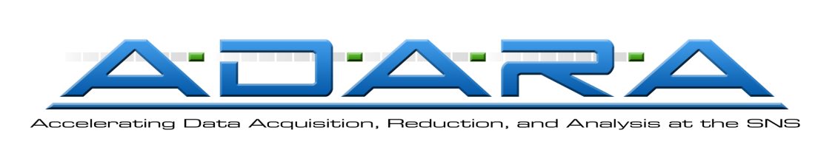
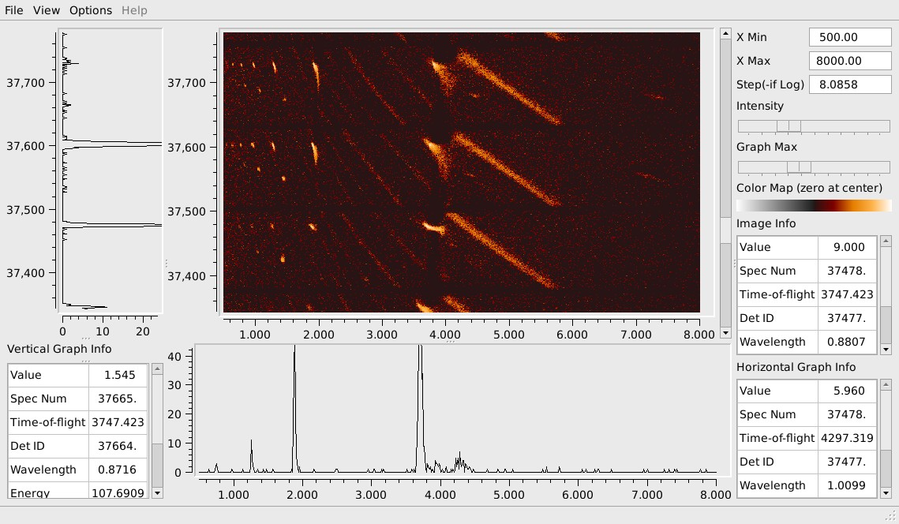
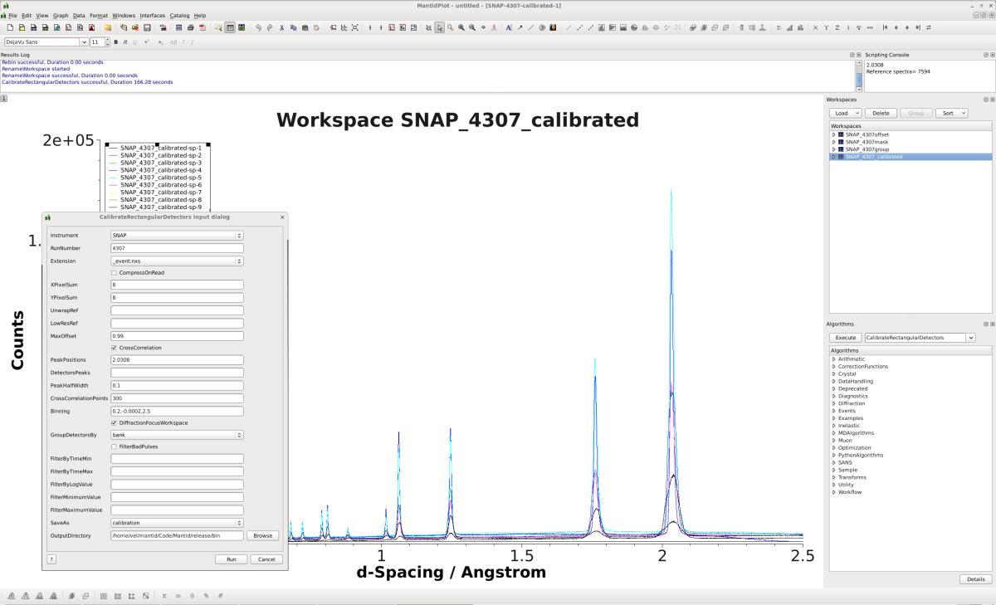
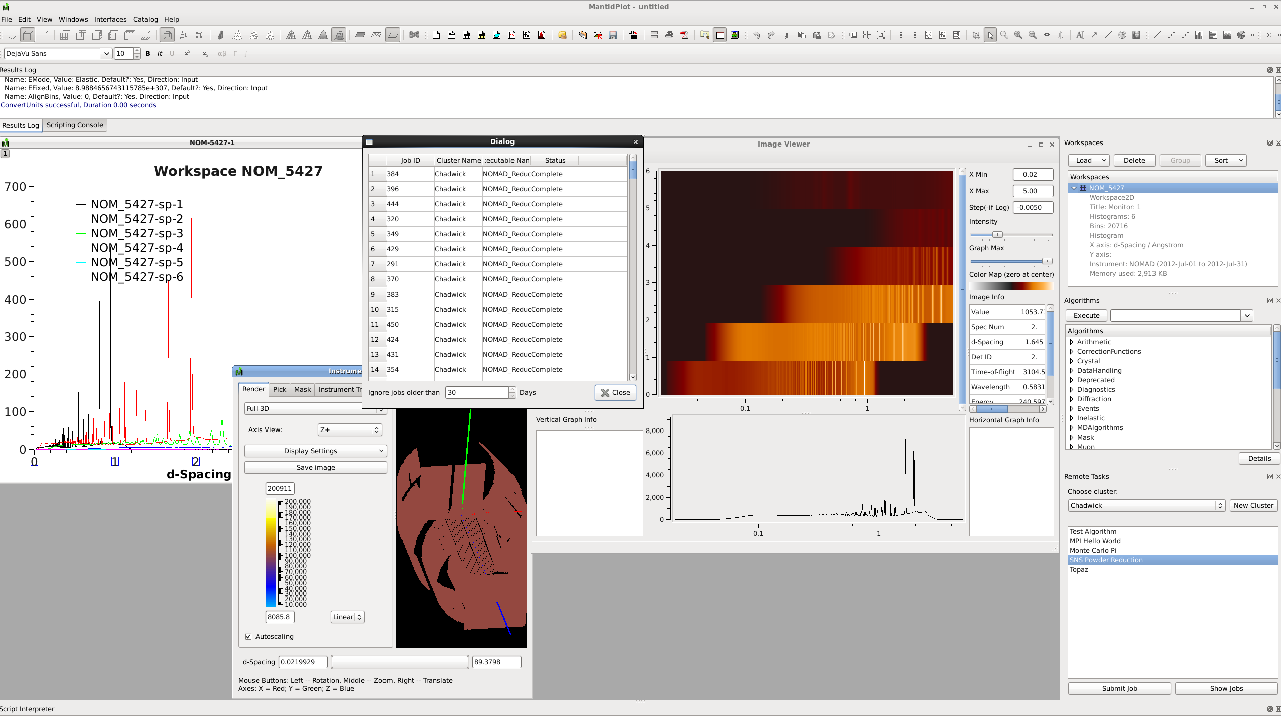
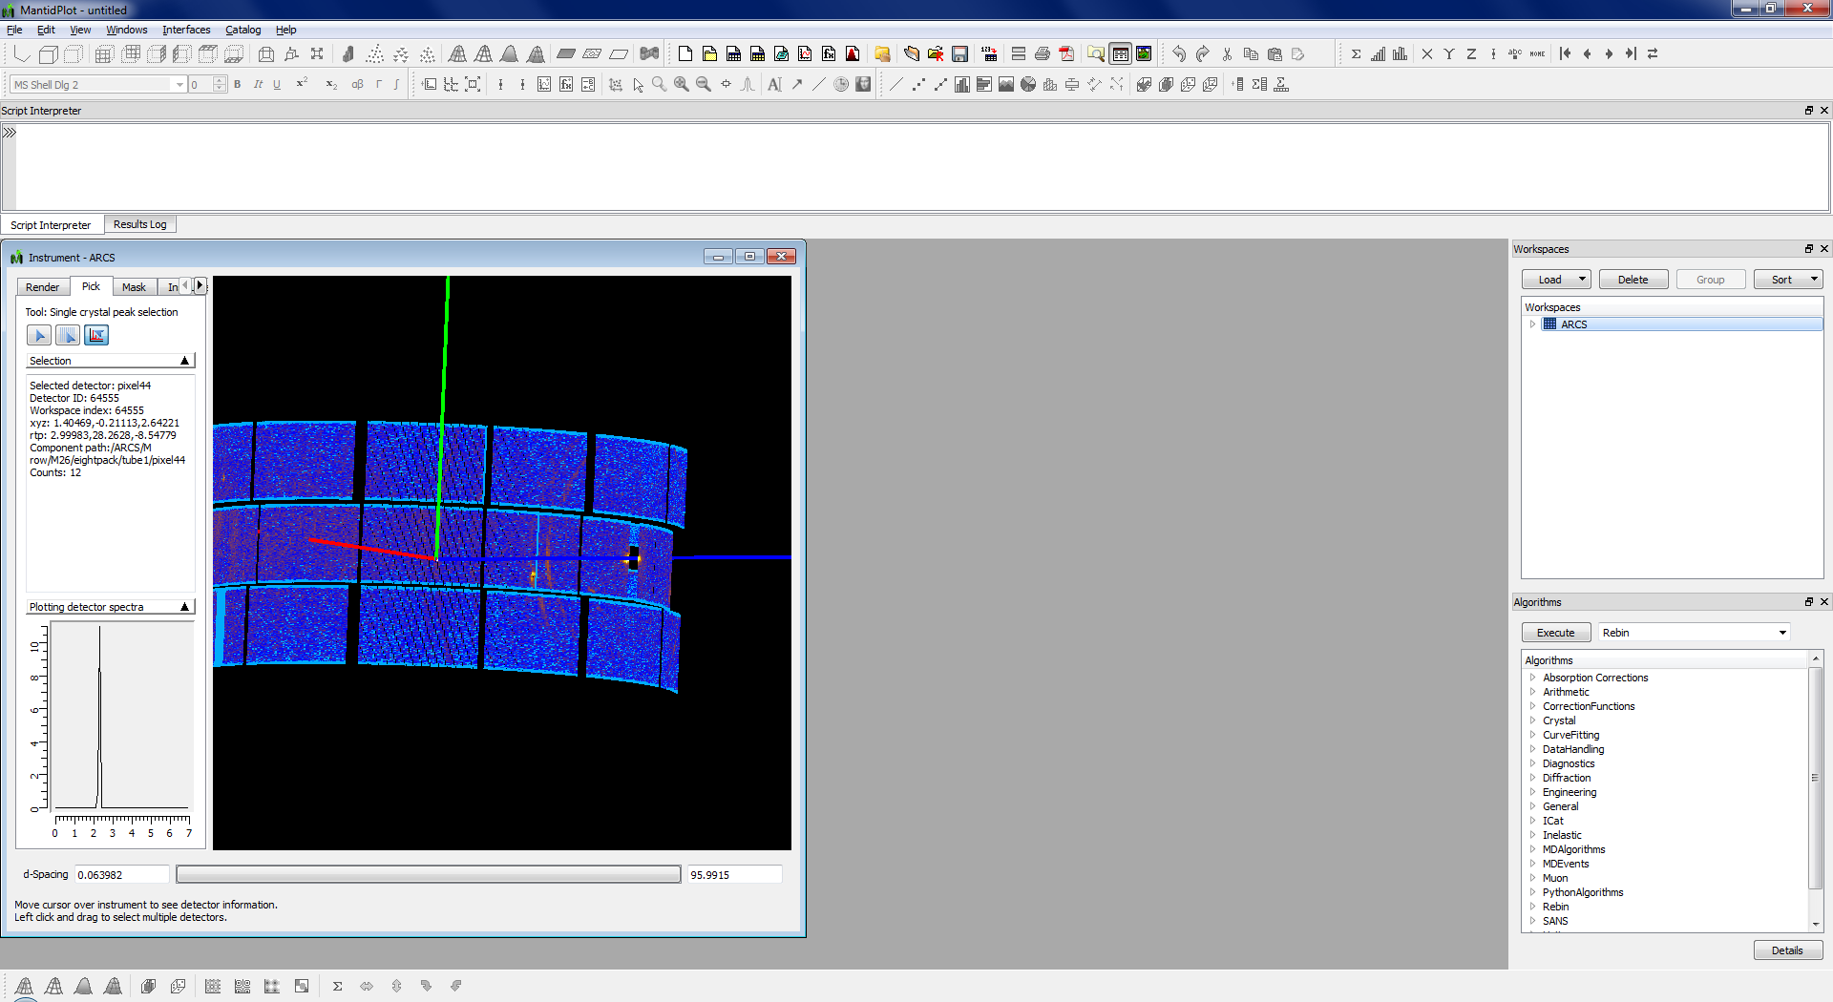
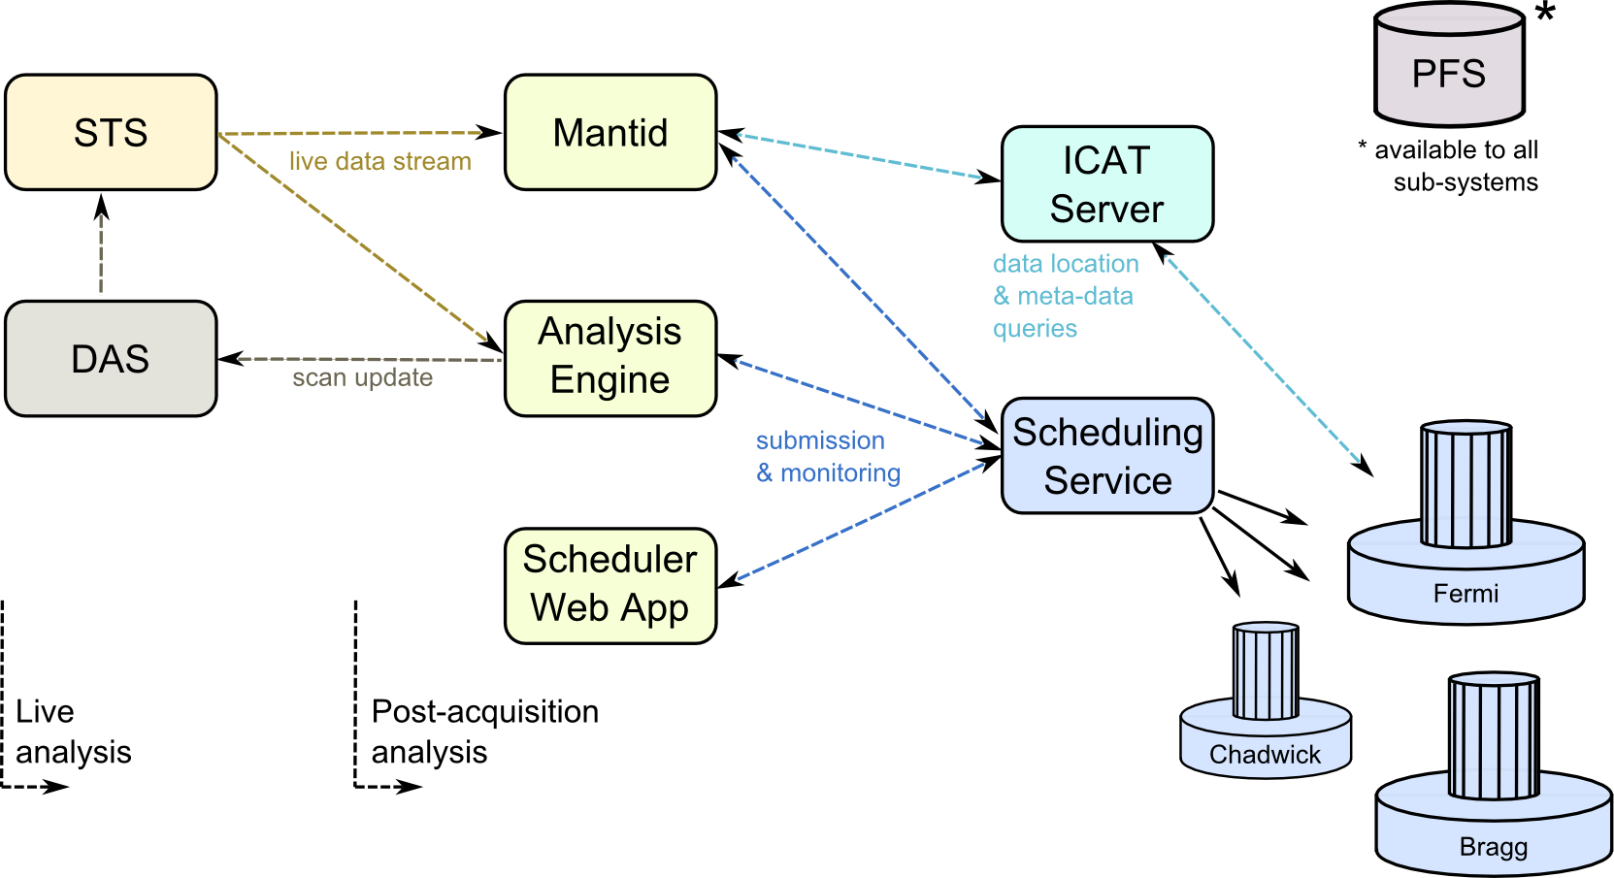
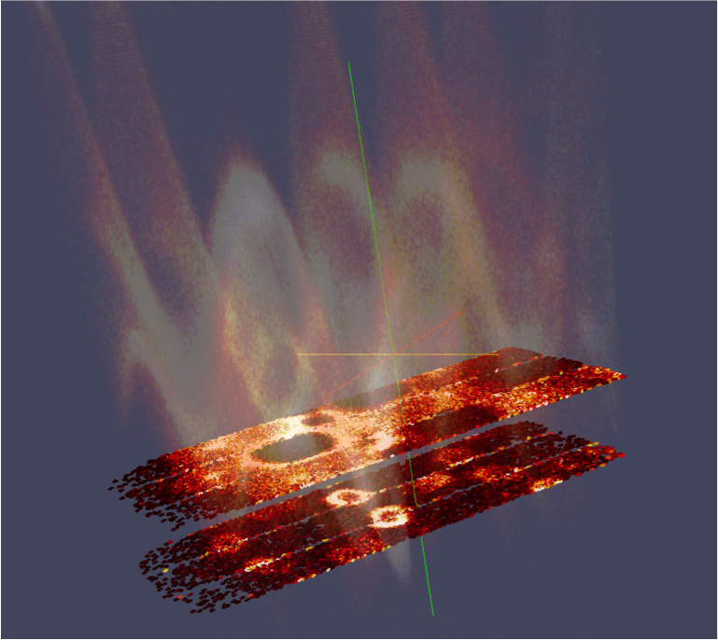
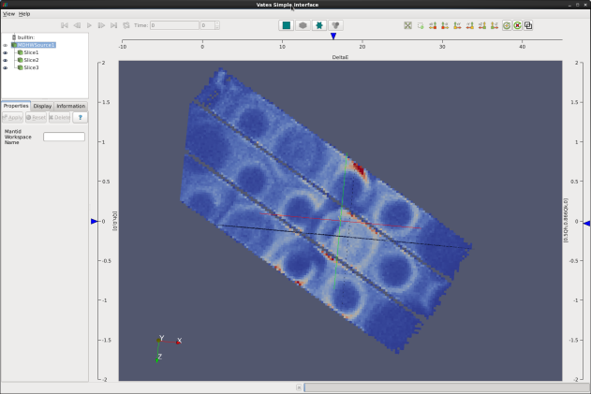
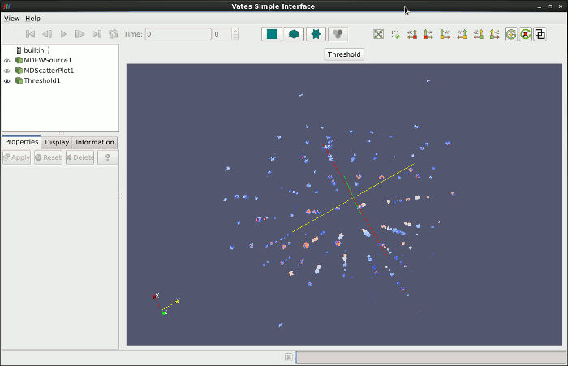
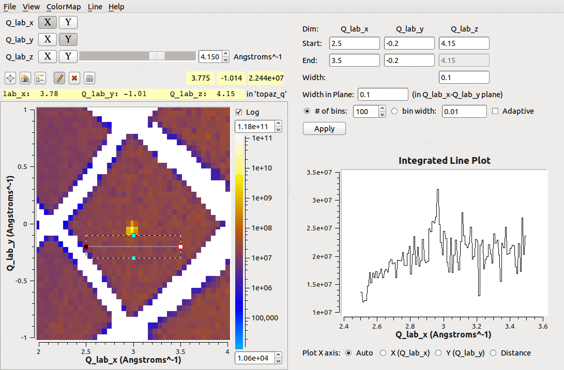
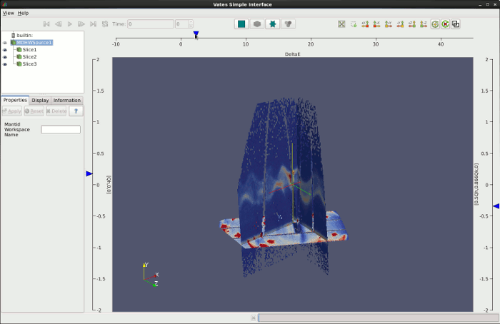
Neutron Data Analysis and Visualization
J. Bilheux, S. Campbell, D. Dillow, M. Doucet, M. Hagen, V. Lynch, D. Mikkelson, R. Mikkelson, R. Miller, M. Mustyakimov, P. Peterson, D. Reitz, S. Ren, M. Reuter, A. Savici, G. Shipman, D. Stansberry, R. Taylor, F. Wang, W. Zhou
Our Mission
Accelerating Data Acquisition, Reduction, and Analysis at SNS
The ability to reduce, and analyze, the data as it is taken
Data files created instantly after acquisition
The ability to reduce a data set post-acquisition in minutes
The resources for any user to do post-acquisition reduction, analysis, visualization, modeling from anywhere
Built on existing foundations–the existing DAS system streams neutron data internally today
We stream data (neutron and SE) from the DAS to a publish subscribe system
Stream Management Service (SMS)
We modify MANTID (data reduction) to read from the data stream live from SMS
Streaming Reduction Service (SRS)
We re-configure the data translation (file creation) to read the data stream from SMS and create the files while the run is taking place… end of run = close file [file appears “instantly”]
Streaming Translation Service (STS)
Files are created on an HPC infrastructure for subsequent parallel analysis and data reduction
We put the resources for analysis there and give the users remote access
Using MANTID at SNS and HFIR
Data reduction, visualization, and analysis framework, instrument and technique agnostic
Collaboration between ORNL and ISIS
Developed in C++, with python bindings
Multiple platforms (Linux, MacOS, Windows)
Freely distributable to visiting scientists
MantidPlot window (left)
ImageView of ARCS data (right)
Users interact with the program via command line, Python scripts, or graphical user interface
The main components are workspaces (collections of data, instrument configurations, sample environment log values, etc.) and algorithms
Neutron scattering data can be analyzed in histogram mode or event mode
Available algorithms: arithmetic, logical operators, data handling, peak finding, curve fitting, rebinning, diagnostics, units conversions, neutron efficiency correction, normalization, specialized algorithms for different techniques (diffraction, SANS, spectroscopy, muon, …)
Plotting
1D scatter or line plot
2D contours or surface plots
3D available through ParaView plugins
Instrument view allows simple diagnostics, masking, sample orientation checks
Access to data using ICAT3
ADARA resource diagram (top)
Live event processing with ADARA and Mantid for HYSPEC data (left)
Remote job submission with ADARA and Mantid for NOMAD reduction (right)
Instrument view of ARCS (left)
ICAT data window (right)
Future
Center for Accelerating Materials Modeling from SNS data (CAMM)
The appropriate computational framework will be developed and implemented:
User Interface
Resource Scheduling (on-demand clusters vs NERSC)
Data Management (experiment & simulation)
Sensitivity (statistical) analysis data/simulations [fitting]
Optimal Experimental Design
Computational “Steering” (Decision Support System)
Material modeling and simulation will provide comparison with experimental data
Modeling, neutron scattering experiment and data analysis will be integrated
Advanced Visualization Examples
Spin waves in gadolinium as measured on SEQUOIA visualized by Vates (left)
Single crystal peaks as measured on TOPAZ visualized by SliceViewer (right)
Looking at the computational framework from the perspective of communication between sub-systems

